Slide 1
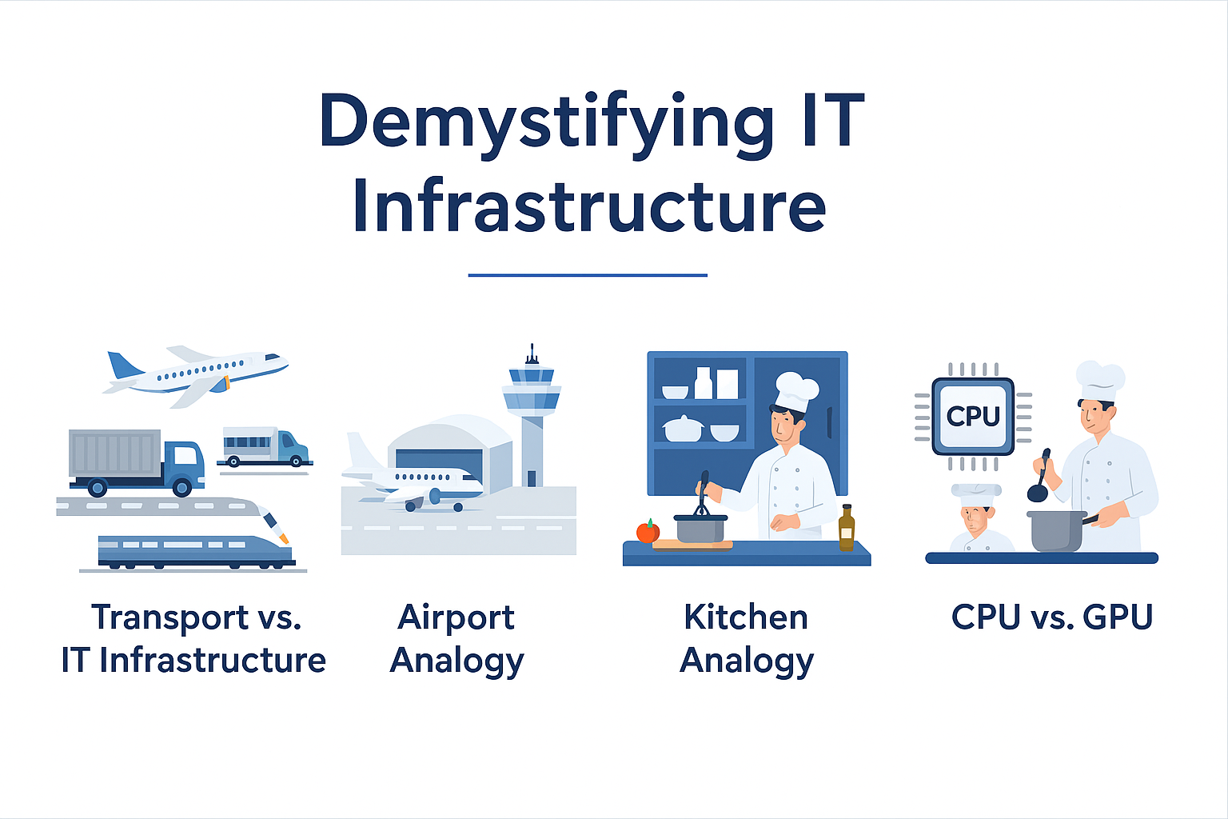
Runways = Network
Planes need clear runways to take off and land, data needs a clear network path to travel. If the runway is blocked (network down), nothing moves.
IP addresses are the street numbers in a city.
Common Terminologies MBps – Megabytes Per Second. GBPS – GigaBytes Per Second. Uplink – The Cable that provides network access to all other ports on the switch. Subnet – Splitting Huge Network into smaller blocks Gateway – the path traffic follows onto a particular network Segment.

